Slide 1
&*%&@#*!
int f (void) {
int s = 1;
int t = 1;
int *ps = &s;
int **pps = &ps;
int *pt = &t;
**pps = 2;
pt = ps;
*pt = 3;
t = s;
}
s == 1, t == 1
s == 2, t == 1
s == 3, t == 1
s == 3, t == 3

Slide 2
Rvalues and Lvalues
What does = really mean?
int f (void) {
int s = 1;
int t = 1;
t = s;
t = 2;
}
left side of = is an “lvalue”
it evaluates to a location (address)!
right side of = is an “rvalue”
it evaluates to a value
There is an implicit * when a variable is
used as an rvalue!

Slide 3
Parameter Passing in C
Actual parameters are rvalues
void swap (int a, int b) {
int tmp = b; b = a; a = tmp;
}
int main (void) {
int i = 3;
int j = 4;
swap (i, j);
…
}
The value of i (3) is passed, not its location!
swap does nothing

Slide 4
Parameter Passing in C
void swap (int *a, int *b) {
int tmp = *b; *b = *a; *a = tmp;
}
int main (void) {
int i = 3;
int j = 4;
swap (&i, &j);
…
}
The value of &i is passed, which is the address of i
Is it possible to define swap in Python?

Slide 5
Beware!
int *value (void)
{
int i = 3;
return &i;
}
void callme (void)
{
int x = 35;
}
int main (void) {
int *ip;
ip = value ();
printf (“*ip == %d\n", *ip);
callme ();
printf ("*ip == %d\n", *ip);
}
*ip == 3
*ip == 35
But it could really be anything!

Slide 6
Manipulating Addresses
char s[6];
s[0] = ‘h’;
s[1] = ‘e’;
s[2]= ‘l’;
s[3] = ‘l’;
s[4] = ‘o’;
s[5] = ‘\0’;
printf (“s: %s\n”, s);
expr1[expr2] in C is just syntactic sugar for
*(expr1 + expr2)
s: hello

Slide 7
Obfuscating C
char s[6];
*s = ‘h’;
*(s + 1) = ‘e’;
2[s] = ‘l’;
3[s] = ‘l’;
*(s + 4) = ‘o’;
5[s] = ‘\0’;
printf (“s: %s\n”, s);
s: hello

Slide 8
Fun with Pointer Arithmetic
int match (char *s, char *t) {
int count = 0;
while (*s == *t) { count++; s++; t++; }
return count;
}
int main (void)
{
char s1[6] = "hello";
char s2[6] = "hohoh";
printf ("match: %d\n", match (s1, s2));
printf ("match: %d\n", match (s2, s2 + 2));
printf ("match: %d\n", match (&s2[1], &s2[3]));
}
&s2[1]
➔&(*(s2 + 1))
➔ s2 + 1
The \0 is invisible!
match: 1
match: 3
match: 2

Slide 9
Condensing match
int match (char *s, char *t) {
int count = 0;
while (*s == *t) { count++; s++; t++; }
return count;
}
int match (char *s, char *t) {
char *os = s;
while (*s++ == *t++);
return s – os - 1;
}
s++ evaluates to s_{pre}, but changes the value of s
Hence, C++ has the same value as C, but has unpleasant side effects.

Slide 10
Quiz
What does s = s++; do?
It is undefined!
If your C programming contains
it, a correct interpretation of your
program could make s = s_{pre} + 1,
s = 37, or blow up the computer.

Slide 11
Type Checking in C
Java: only allow programs the compiler can prove are type safe
C: trust the programmer. If she really wants to compare apples and oranges, let her.
Python: don’t trust the programmer or compiler – check everything at runtime.
Exception: run-time type errors for downcasts and array element stores.

Slide 12
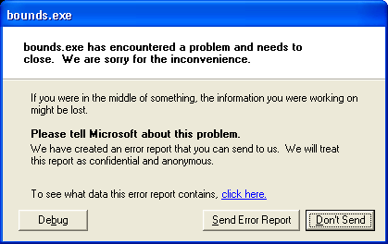
Type Checking
int main (void) {
char *s = (char *) 3;
printf ("s: %s", s);
}
Windows XP (SP 2)

Slide 13
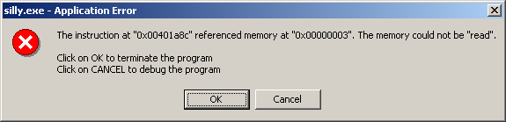
Type Checking
int main (void) {
char *s = (char *) 3;
printf ("s: %s", s);
}
Windows 2000
(earlier versions of Windows would just crash the whole machine)

Slide 14
Exercise
Study Section 6.3 from the textbook

Slide 15
Skip
Study section 6.5 from the textbook
We studied section 6.6 Strings under one dimensional char arrays in ch 5

Slide 16
6.7 Dynamic Memory Allocation
Dynamically allocated memory is determined at runtime
A program may create as many or as few variables as required, offering greater flexibility
Dynamic allocation is often used to support data structures such as stacks, queues, linked lists and binary trees.
Dynamic memory is finite
Dynamically allocated memory may be freed during execution

Slide 17
Dynamic Memory Allocation
Memory is allocated using the:
malloc function (memory allocation)
calloc function (cleared memory allocation)
Memory is released using the:
free function
The size of memory requested by malloc or calloc can be changed using the:
realloc function

Slide 18
malloc and calloc
Both functions return a pointer to the newly allocated memory
If memory can not be allocated, the value returned will be a NULL value
The pointer returned by these functions is declared to be a void pointer
A cast operator should be used with the returned pointer value to coerce it to the proper pointer type

Slide 19
Example of malloc and calloc
int n = 6, m = 4;
double *x;
int *p;
/* Allocate memory for 6 doubles. */
x = (double *)malloc(n*sizeof(double));
/* Allocate memory for 4 integers. */
p = (int *)calloc(m,sizeof(int));
X
p

